Slide 1
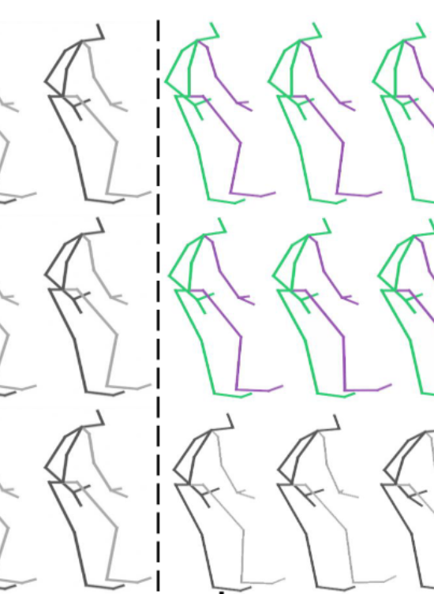
Towards Real-Time Human Motion Prediction using Data-Driven and Physics-Based Models
From literature to reality
Notes:
-presenting the current state of my master thesis, on …
-combines insights from my literature study with the upcoming research plan

Slide 2
Contents
Motivation & Goal
Literature Landscape
Model Architectures
Prediction Example
Real-Time Focus & Onwards
Notes:
by explaining my methodology and breaking down the relevant themes I have found in the literature
Using those insights I will highlight the most common .. and discuss key techniques and trends

Slide 3
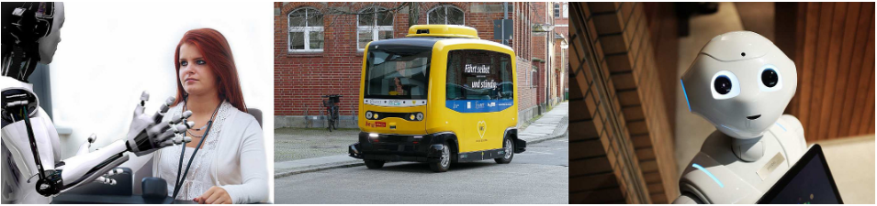
Motivation & Context
Shared workspaces between robots and humans
Company motivation
Move beyond offline prediction
[1]
Motivation & Goal
|
Literature Landscape
|
Model Architectures
|
Prediction Example
|
Real-Time Focus & Onwards
Notes:
- interactive system where drones respond to dancers in real time.

Slide 4
Methodology
Available Human Motion Prediction models
Two Step approach
Global search in Human Intent Prediction
Targeted search in Human Motion Prediction
  Using insights from the global search
Resulted in three distinct categories:
Pedestrian Intent Prediction
Intent Prediction in Human Robot Interaction
Human Motion Prediction
Motivation & Goal
|
Literature Landscape
|
Model Architectures
|
Prediction Example
|
Real-Time Focus & Onwards
Notes:
- My focus is especially on the last category

Slide 5
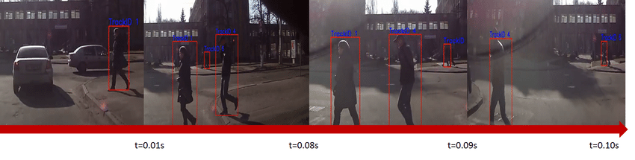
Thematic Breakdown – Pedestrian Intent PRediction
Most often posed as Classification Task
Trained on urban imagery
Neural Networks are used, most pre dominantly Graph-based methods
[2]
Introduction & Motivation
|
Literature Landscape
|
Model Architectures
|
Prediction Example
|
Real-Time Focus & Onwards
Notes:
and use 2D vision or pose data.
Neural networks are used, and most pre dominantly Graph-based methods. These methods allow for modelling of pedestrians and objects as nodes in an interaction graph, capturing the dependencies between them

Slide 6
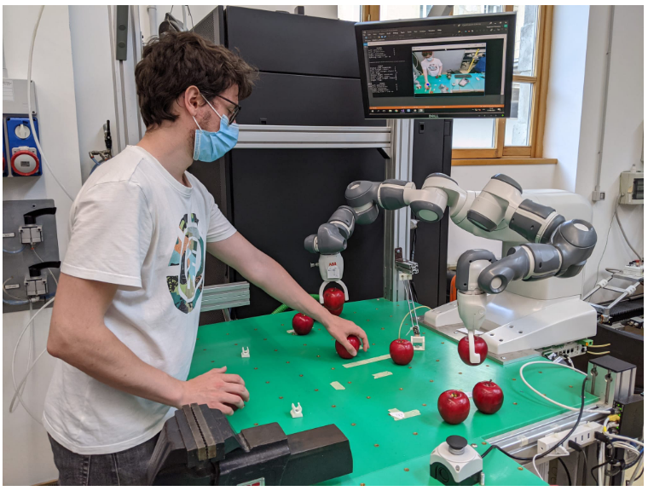
Thematic Breakdown – Intent Prediction in HRI
[3]
Split into:
Independent Task Prediction
Collaborative Task Prediction
Usually has strict sets of actions
Makes use of probalistic frameworks (e.g. Markov Decision Processes)
Introduction & Motivation
|
Literature Landscape
|
Model Architectures
|
Prediction Example
|
Real-Time Focus & Onwards
Notes:
where human and robot actions are separate from each other and have different goals
where a robot’s behavior depends directly on human motion, like in assembly lines or handover tasks

Slide 7
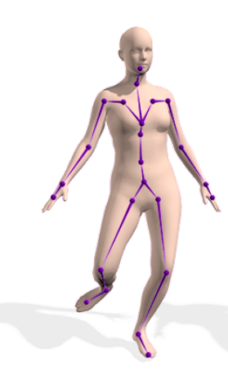
Thematic Breakdown – Human Motion Prediction
[4]
Continuous pose forecasting
Mainly uses motion capture data, transformed into skeleton keypoints
Has two main methods:
Data-Driven approaches
Physics-Based models
Introduction & Motivation
|
Literature Landscape
|
Model Architectures
|
Prediction Example
|
Real-Time Focus & Onwards
Notes:
continuous pose forecasting using motion capture data as an input.
such as RNNs, GCNs. In these types of approaches, a model is trained using a lot of data, where a loss function is used to find the correct model that outputs the correct movement given a certain input.

Slide 8
Key Techniques & Trends
Data-driven approaches:
Driven by pattern recognition
Physics-based models
Grounded in rules of physics/dynamics
RNN: Sequential modeling
GCN: Spatial modeling
Differential equations (like Euler-Lagrange)
Dynamic constraints
Introduction & Motivation
|
Literature Landscape
|
Model Architectures
|
Prediction Example
|
Real-Time Focus & Onwards
Notes:
Over time GCNs have become increasingly dominant in the literature. They outperform in modeling full-body movement over time and are robust when joints influence each other, for example, your elbow’s position is influenced by your shoulder’s position. However, they can struggle with real-world noise, occlusion, or irregularities in the input data.

Slide 9
Key Techniques & Trends
Data-driven approaches:
Driven by pattern recognition
Physics-based models
Grounded in rules of physics/dynamics
Great at capturing dependencies over a longer horizon
GCNs can capture spatial depencencies between joints
Can generate “impossible” poses
Great at capturing dependencies over a shorter horizon
Enforces plausible movement patterns
Performance deteriotates when prediciting for long horizons
Introduction & Motivation
|
Literature Landscape
|
Model Architectures
|
Prediction Example
|
Real-Time Focus & Onwards

Slide 10
Key Techniques & Trends
Data-driven approaches:
Driven by pattern recognition
Physics-based models
Grounded in rules of physics/dynamics
Hybrid models
Physics-based part → Short-term horizon
Data-driven → Long-term horizon
Introduction & Motivation
|
Literature Landscape
|
Model Architectures
|
Prediction Example
|
Real-Time Focus & Onwards

Slide 11
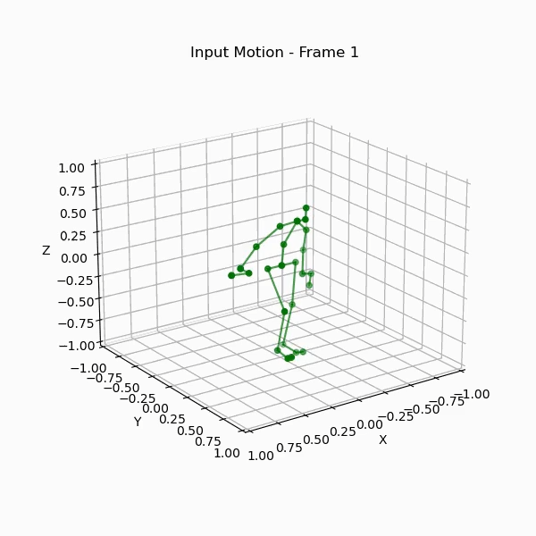
From Past Poses to Future Motion
Input motion
Frames of joint coordinate data
Fixed amount of frames
Introduction & Motivation
|
Literature Landscape
|
Model Architectures
|
Prediction Example
|
Real-Time Focus & Onwards

Slide 12
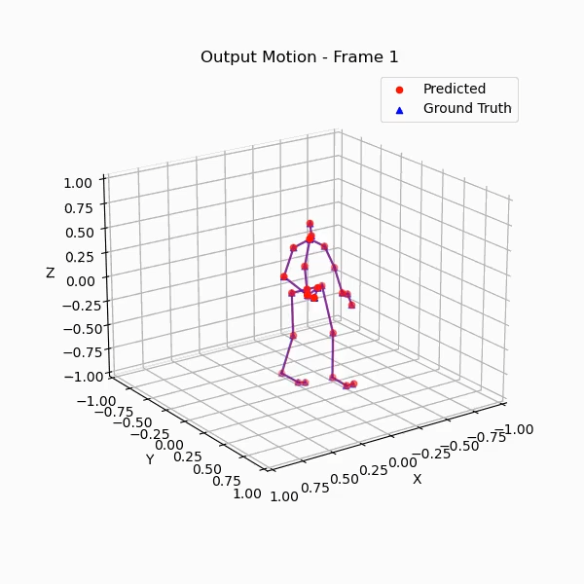
From Past Poses to Future Motion
Input motion
Frames of joint coordinate data
Fixed amount of frames
Output motion
Predicts up to one second into the future
Ground Truth motion
Used to evaluate the predictions
Introduction & Motivation
|
Literature Landscape
|
Model Architectures
|
Prediction Example
|
Real-Time Focus & Onwards

Slide 13
Limitations in Literature
Lack of Global predictions
Lack of Real-World application
Lack of Real-Time predictions
1
2
3
Introduction & Motivation
|
Literature Landscape
|
Model Architectures
|
Prediction Example
|
Real-Time Focus & Onwards

Slide 14
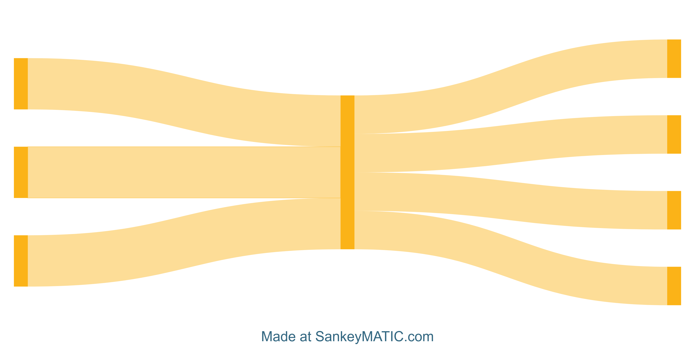
Thesis Plan & Timeline
Literature Research
Thesis Part 1
Thesis Part 2: Possible research angles
Performance Issues
Model Architecture
Latency Issues
Dataset Choice
Implementation
Model Fusion
Sensor Modality
User Feedback
Introduction & Motivation
|
Literature Landscape
|
Model Architectures
|
Deep Dives: Two Representative Models
|
Real-Time Focus & Onwards

Slide 15
Conclusion
Human motion prediction is crucial for intelligent robots interacting with people.
Data-driven models dominate academic research, especially GCNs.
Physics-based methods offer realism and stability, especially in short-horizon contexts.
Notable gap in real-time application
Introduction & Motivation
|
Literature Landscape
|
Model Architectures
|
Deep Dives: Two Representative Models
|
Real-Time Focus & Onwards

Slide 16
References
[1] Tenghao Deng and Yan Sun. “Recent advances in deterministic human motion prediction: A
review”. In: Image and Vision Computing 143 (Mar. 2024), p. 104926. ISSN: 0262-8856. DOI:
10.1016/j.imavis.2024.104926.
[2] F. Piccoli et al., “FuSSI-Net: Fusion of Spatio-temporal Skeletons for Intention Prediction Network,” arXiv (Cornell University), May 2020, doi: https://doi.org/10.48550/arxiv.2005.07796.
[3] Federico Formica et al. “Neural Networks based Human Intent Prediction for Collaborative Robotics
Applications”. In: 2021 20th International Conference on Advanced Robotics (ICAR). Dec. 2021,
pp. 1018–1023. DOI: 10.1109/ICAR53236.2021.9659328.
[4] Naureen Mahmood et al. “AMASS: Archive of Motion Capture as Surface Shapes”. In: Interna-
tional Conference on Computer Vision. Oct. 2019, pp. 5442–5451.
Introduction & Motivation
|
Literature Landscape
|
Model Architectures
|
Deep Dives: Two Representative Models
|
Real-Time Focus & Onwards

